Slide 1
Financial Model for a food industry start-up
By:
Aadithya Santhanakrishnan

Slide 2


Business Question: Should we diversify into selling beverages?

Slide 3
Agenda
Financial Model:
Income statement
Balance sheet
Statement of cashflows
Fixed assets
Sensitivity Analysis:
Goal seek
Solver
Scenario analysis

Slide 4
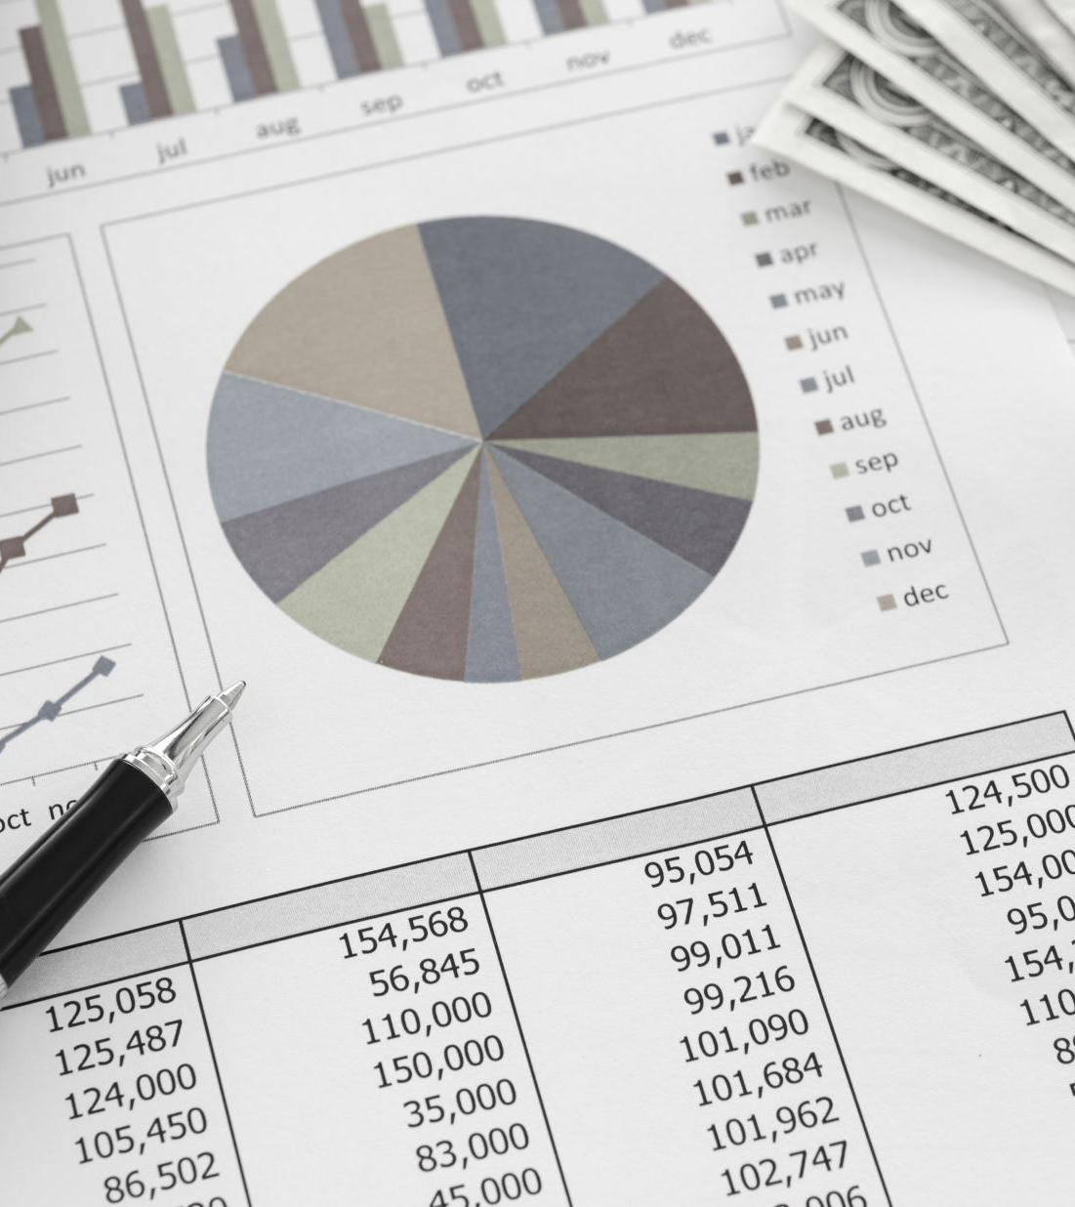
Problem Statement
Create a three statement model linking the income statement, balance sheet, and cash flow statement into a dynamic financial model used for valuation.
Using current year as an absolute, estimate the financials for the next 4 years.
Use sensitivity analysis, scenario analysis, and goal seek/solver to evaluate different scenarios and forecast how a business is going to perform.

Slide 5
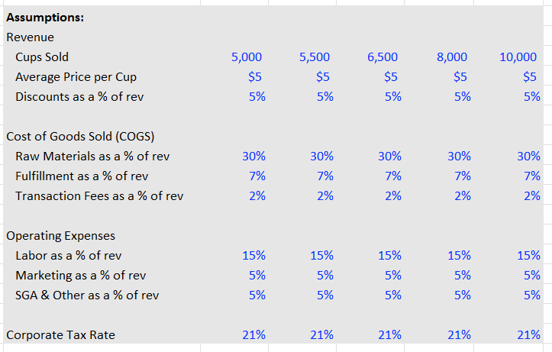
Three Statement Model
Build the income statements using the general assumptions.
Goal of the income statement is to calculate factors like Net Revenue, Gross Profit, Depreciation and Amortisation of assets, Cost of Goods Sold(COGS).

Slide 6
Trend over 5 years
Using the model, we predict the performance of our start up over the next 5 years.
The model shows a constant uptick of gross profit over the upcoming 5 years.

Slide 7
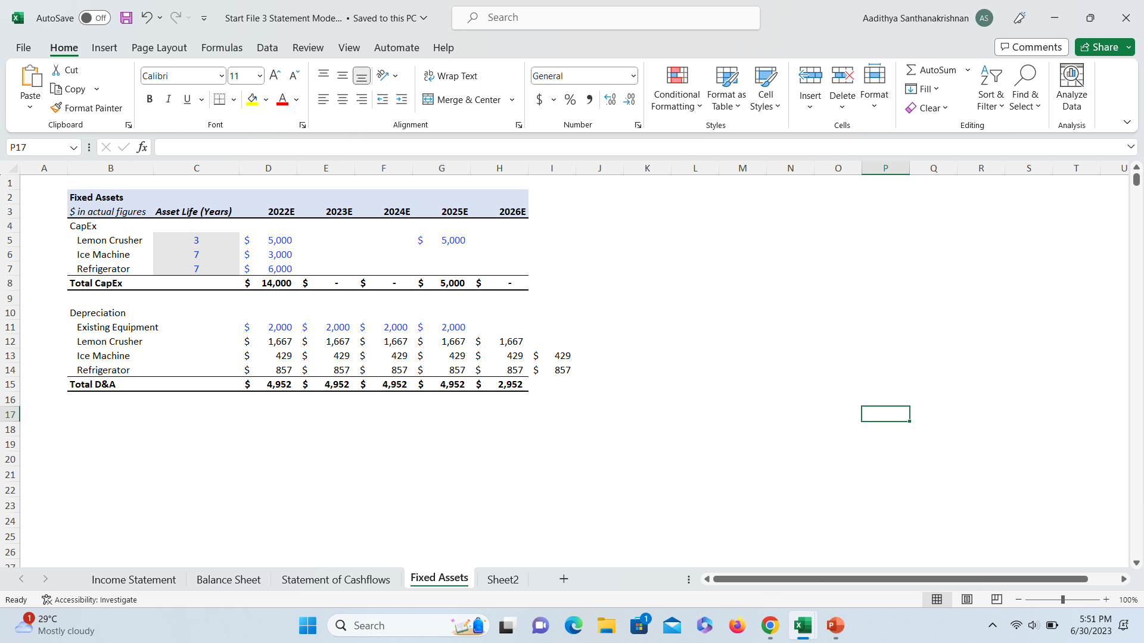
Asset valuation
Valuation of our assets is based on the cost of acquisition as well the depreciation over the years.

Slide 8
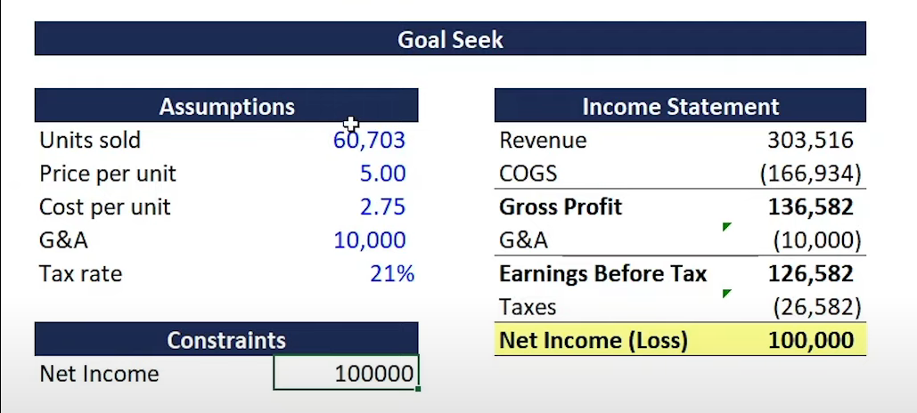
Goal Seek
Goal Seek is a powerful tool in Microsoft Excel that allows you to find the input value needed to achieve a desired output value.
Here we use it to assist us to reach $100k gross revenue from our start up.

Slide 9
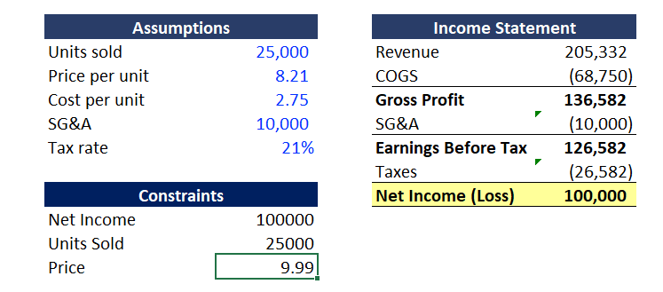
Solver
Solver is an add-in tool in Microsoft Excel that allows you to find the optimal solution for complex optimization problems
Unlike goal seek, Solver allows us to manipulate multiple variables in one iteration.

Slide 10
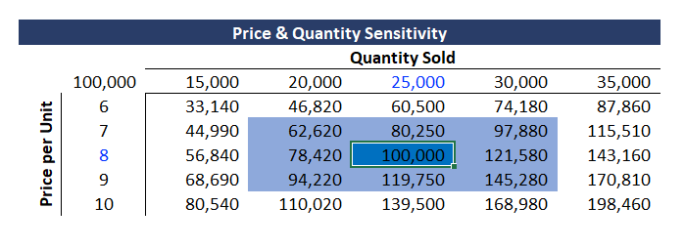
Sensitivity
Sensitivity analysis in Excel refers to the process of examining how changes in input variables impact the output or results of a model
Helps us identify the variables that have the most significant influence on our analysis.

Slide 11
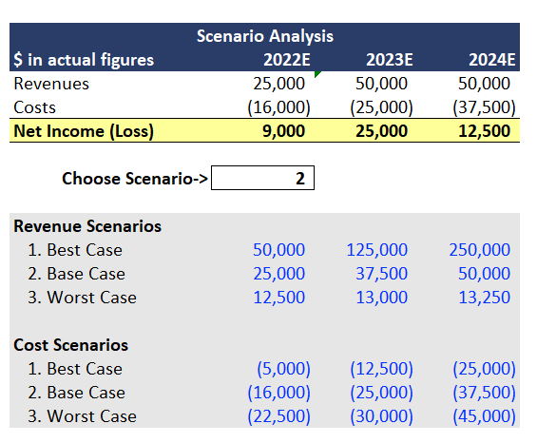
Scenario Analysis
Scenario analysis in Excel involves creating and analyzing multiple scenarios or alternative assumptions.
It helps assess the potential outcomes and impacts on a financial model or decision-making process.
It helps in understanding the range of possibilities and their associated risks or opportunities.

